Slide 1
#TeamAwesome
Machine Learning

Slide 2
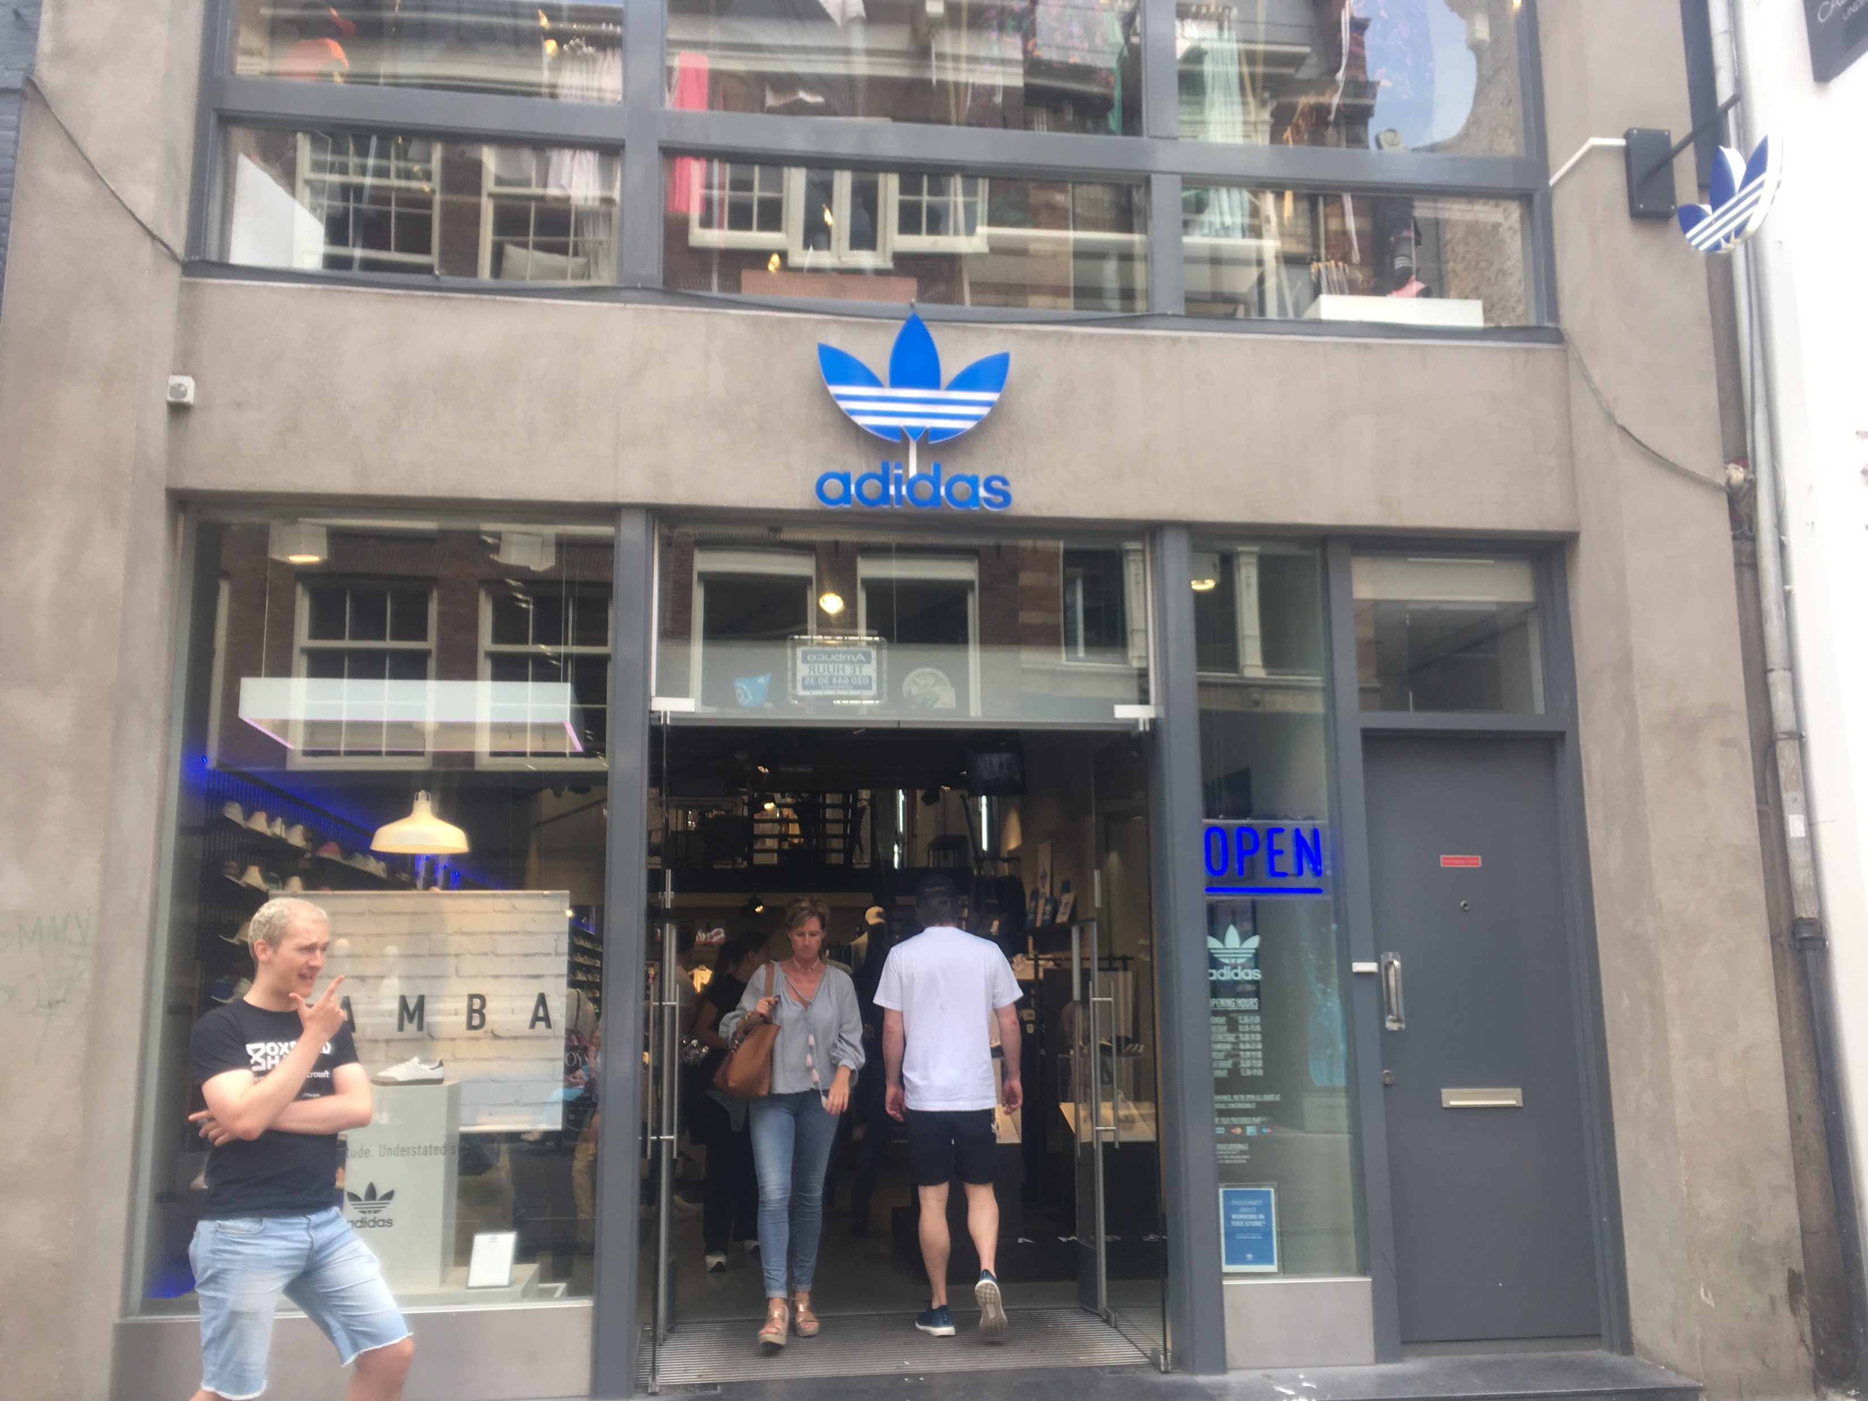
New sneakers?

Slide 3
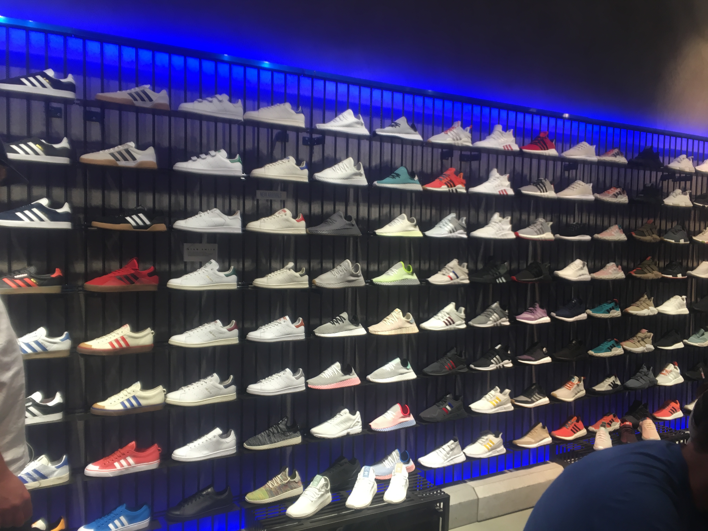
Going to the store
Buying new shoes
Overwhelming selection
No idea how to find something
Unfiltered Sneaker Madness
NOT PERSONAL

Slide 4
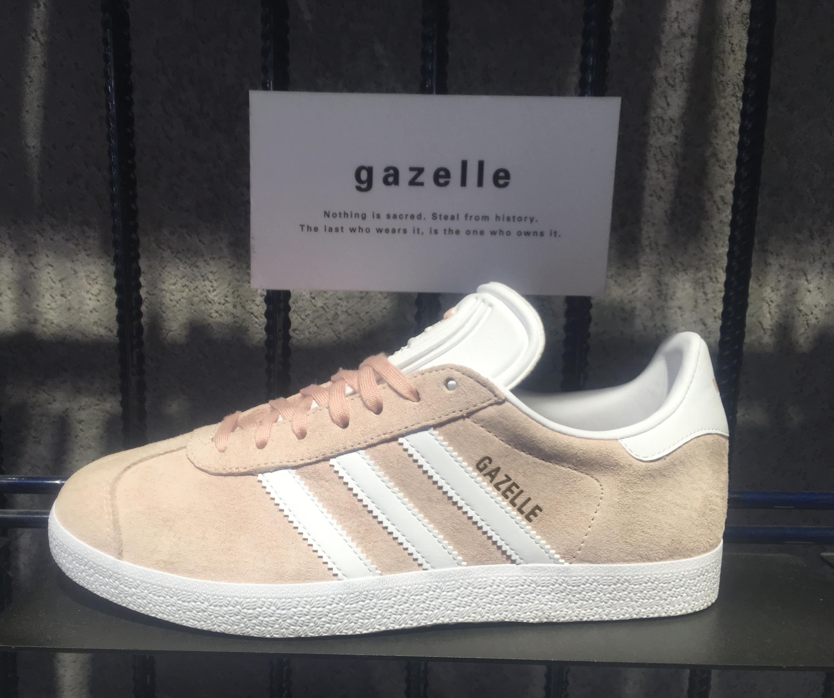
Going to the store
Looks nice
Description some cryptic marketing jargon
No clue if properties are what I’m looking for
NOT PERSONAL

Slide 5
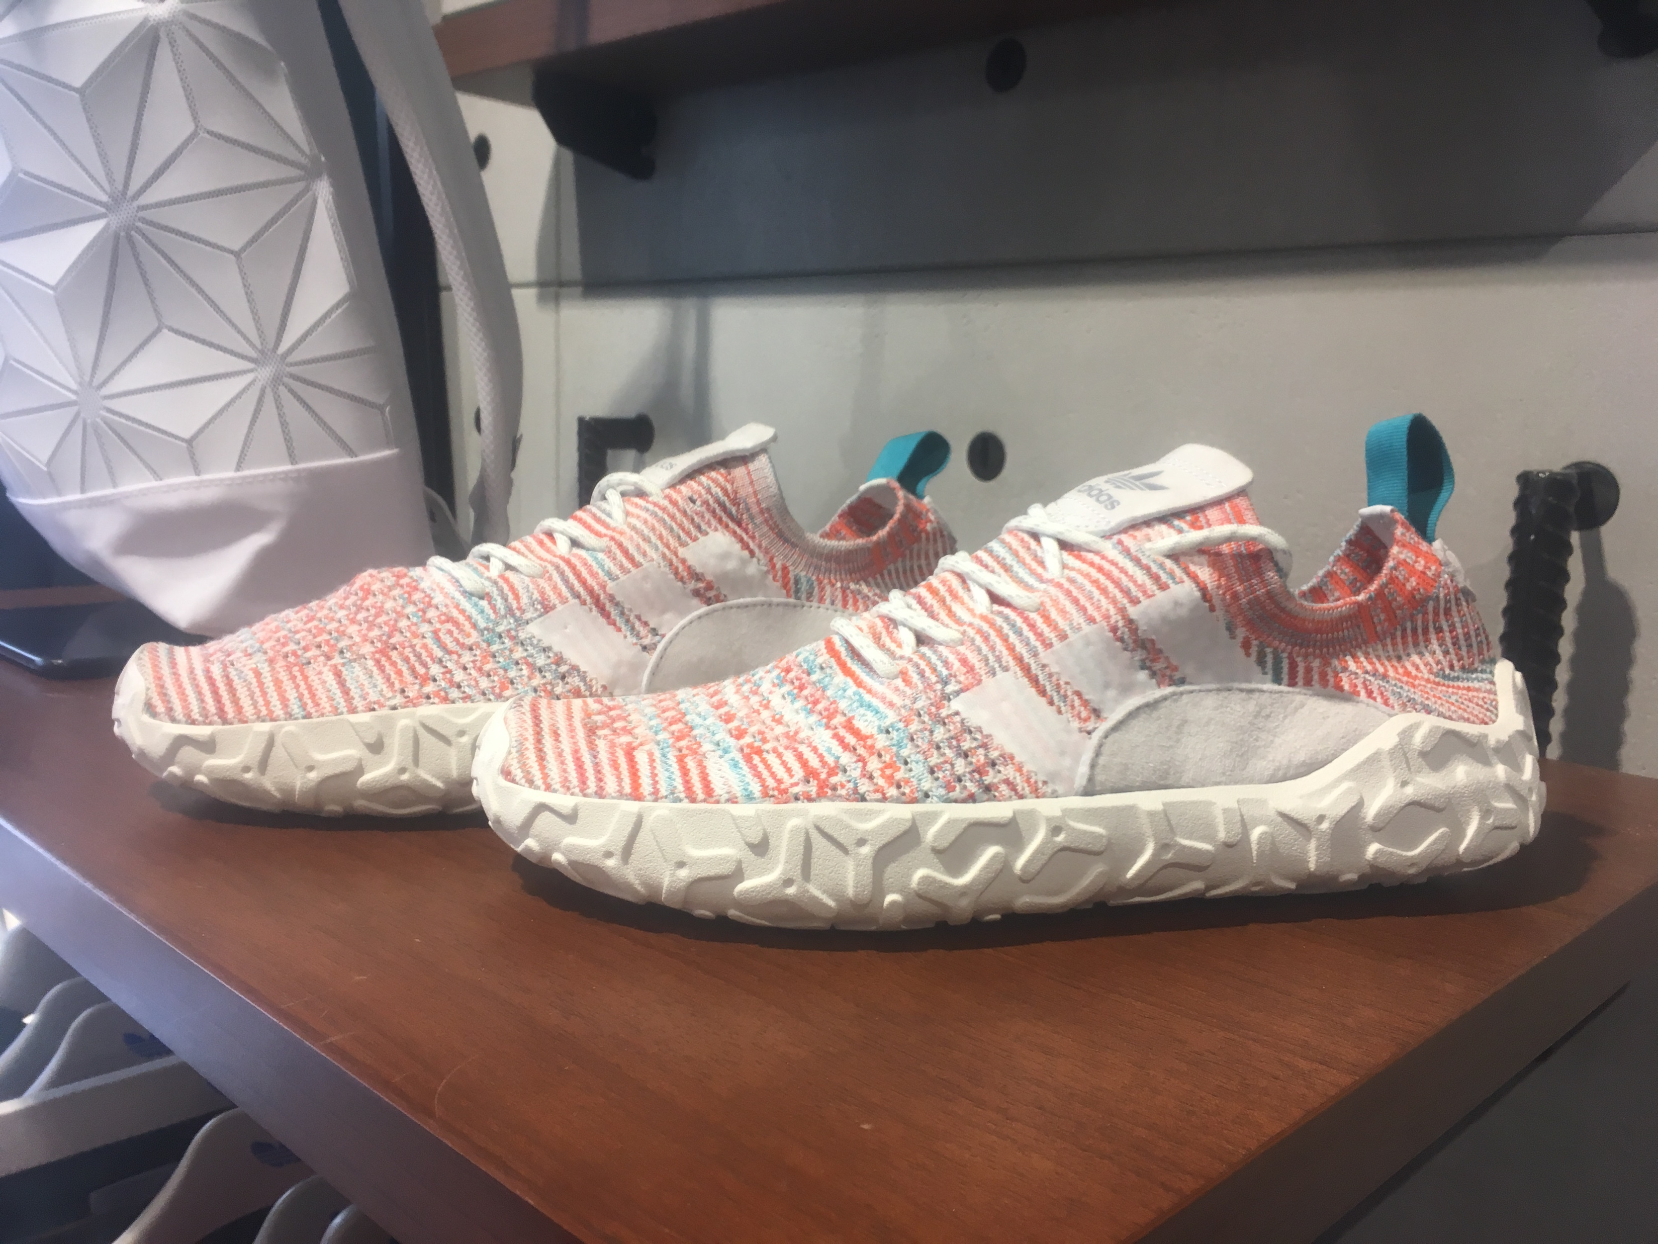
Going to the store
These look fancy
No description at all
Oh, wow some fancy continental™ rubber sole
Wouldn’t have known about that at all
NOT PERSONAL

Slide 6
Leaving the store without making any purchase. This whole thing is just too confusing and randomly arranged. Maybe I can find some nice shoes online where I can filter the whole selection.

Slide 7
Just lost a potential customer who might never return or just buy shoes at another retailer. Reason: In store experience is unorganized and without any guidance on what might be a good fit for the user.

Slide 8
IoT driven virtual assistant that seamlessly merges online and offline shopping experience via personalized interactions.

Slide 10
Demo Time
[VIDEO LINK]

Slide 11
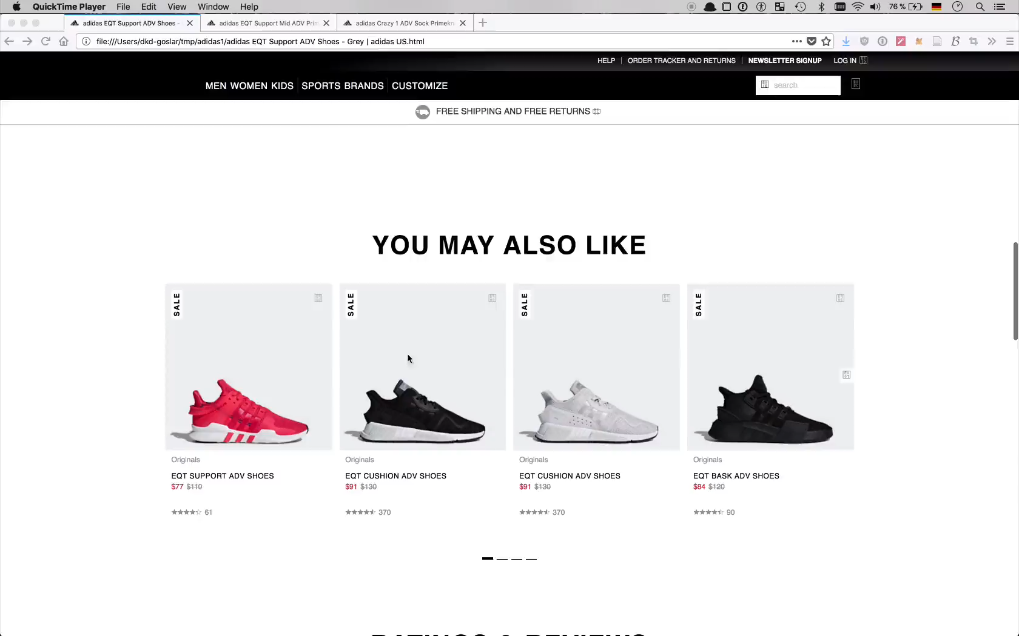

Slide 12
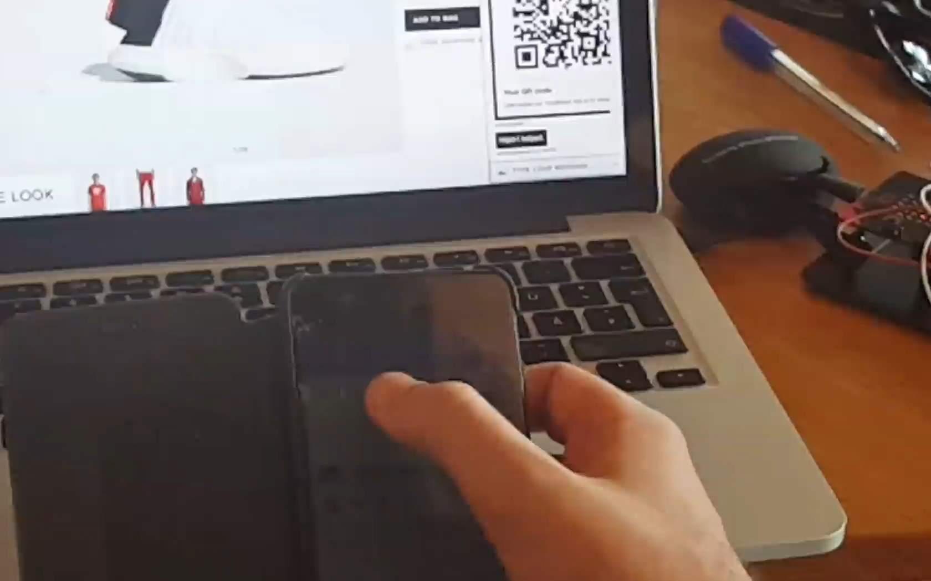

Slide 13
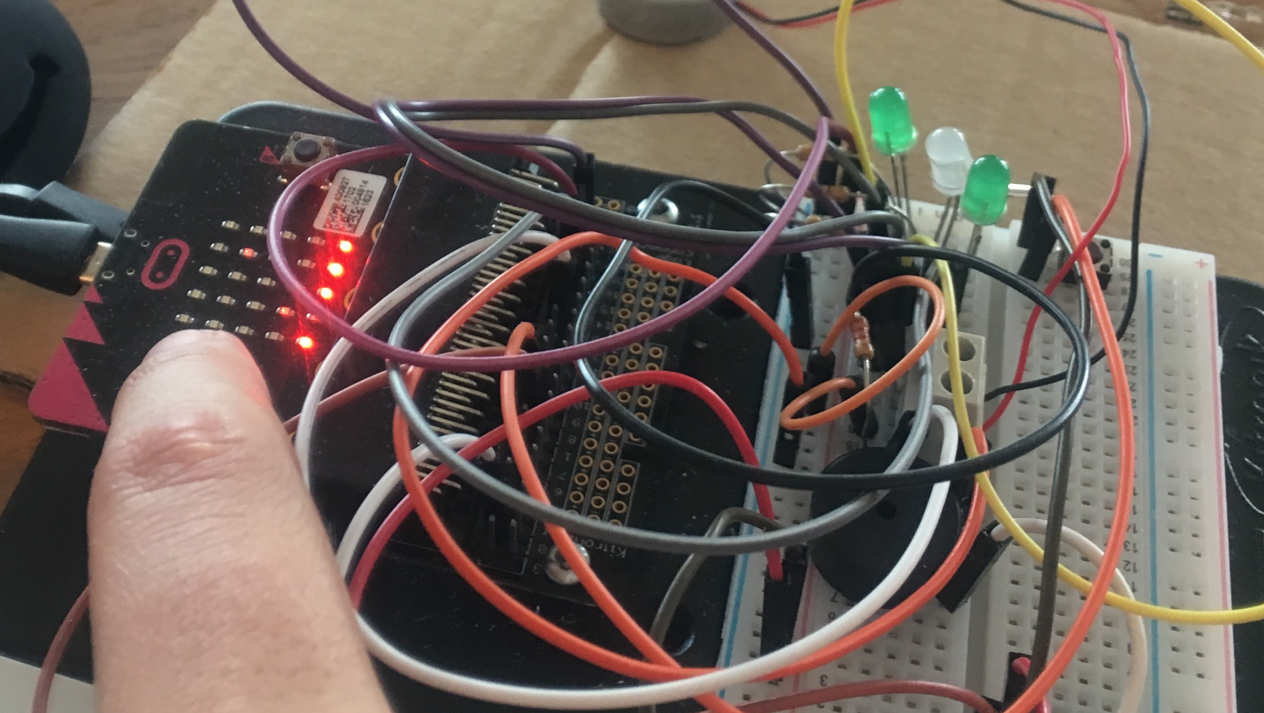
Adi-Blink
Leverage store data available
e.g., find the shoes that are available in your size
Visual feedback to find the product you are looking for, started by app interaction

Slide 14
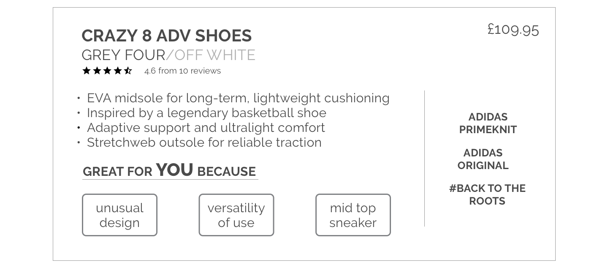
Adi-Pick
Provide additional information for the product that is being picked up
Empty wall space used as projection screen to show product related infos and media
Next to general product information, customer profile specific preferences pointed out to curate a personal shopping experience

Slide 15
Conclusion
Finally a way to bring the personalized online experience to the store
Personal shopping experience created leveraging customer profile data
People come to the store for the haptic and personal experience

Slide 16
Thank You!
#WhatJustHappened

